Slide 1



Creating a Respectful Workplace Culture
Notes:
Tell: Hello, and welcome to Creating a Respectful Workplace Culture training.

Slide 2
Pre-Training Requirements:
Print the following document located on the Café LA Website on the Training page, it is incorporated into this training video:
Disrespectful vs Unprofessional Worksheet
Notes:
Tell: Before you begin it is necessary for you to print the Civil Rights SOP located on the Café LA Website on the SOP page.
Tell: Please note that you are required to review the SOP Civil Rights in detail, before or during this training. By completing this training you are certifying you have viewed all the listed documents and this training in its entirety.

Slide 3



Respect Can Mean Different Things
Respect is a commonly used term that we often read about in news articles, use in our employee handbooks, and even hear in famous songs.
Articles
Employee Handbook
Famous Song
Notes:
TELL: Respect can mean many different things. Respect is a commonly used term that we often read in articles online, use in our very own employee handbooks, and even hear in famous songs, like R-E-S-P-E-C-T.

Slide 4
RESPECT
OWED AND EARNED
Notes:
TELL: Let’s talk about the two types of respect.

Slide 5

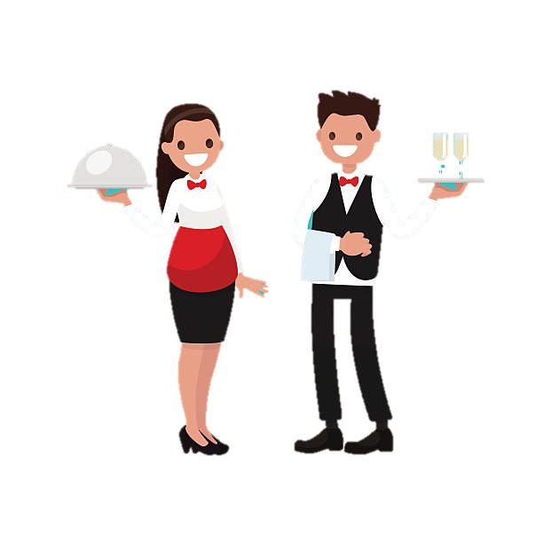
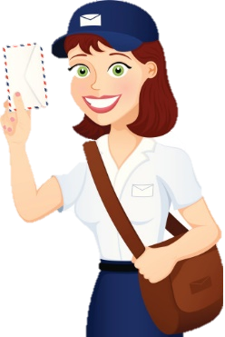
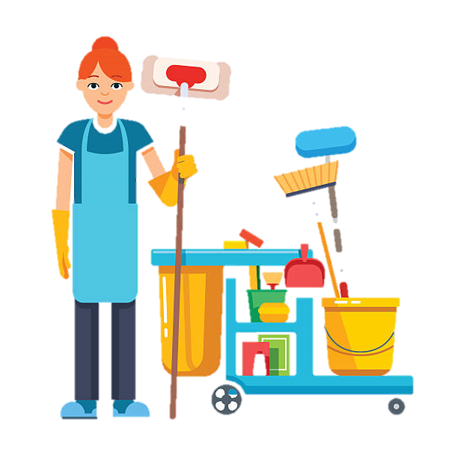
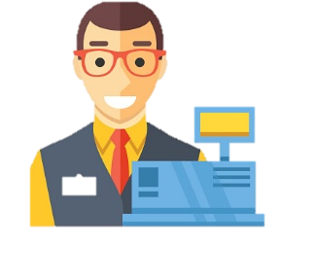

What are some other examples of people you know whom you give or receive respect from?
Mail Carrier
Custodians
Type 1: Owed Respect
Store Cashier
Wait Staff
Owed respect is the due regard for the feelings, wishes, rights, or traditions of others
Notes:
TELL: The second type of respect we’ll be talking about is Owed Respect. Owed respect is the basic respect and consideration all people deserve. We owe it to each other to treat one another with decency, civility, and professionalism.
ASK: What are some other examples of people you know whom you give or receive respect from?
INSTRUCTOR: Solicit feedback from audience.
CLICK
TELL: We owe basic respect to the store cashier, your co-worker, a stranger, basically every human being.

Slide 6
RESPECT
OWED AND EARNED
Notes:
TRANSITION SLIDE ONLY

Slide 7
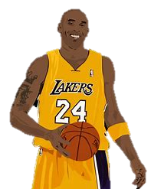
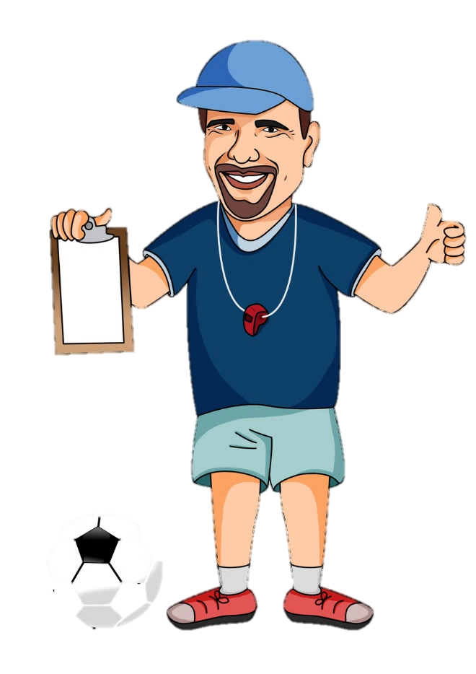
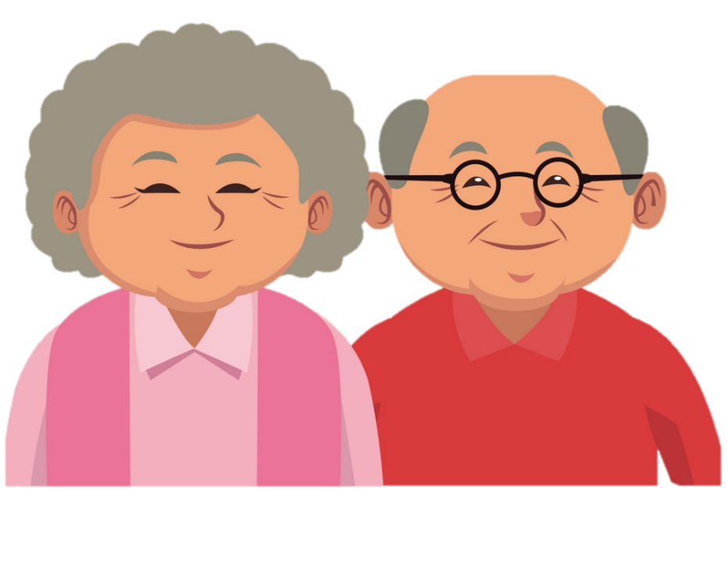
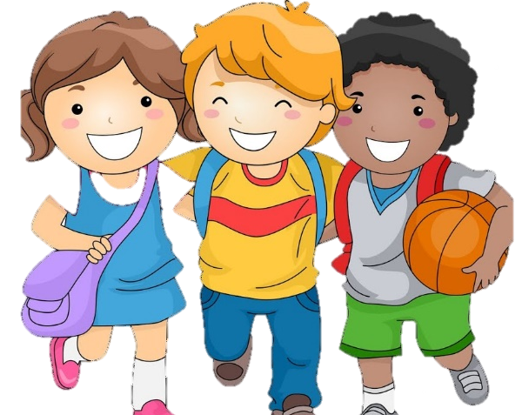

What are some other examples of people you know who have earned your respect?
Grandparents
Friends
Type 2: Earned Respect
Earned respect comes from a feeling of admiration for an individual for their abilities, qualities, or achievements.
Mentor/Coach
Celebrities
Notes:
TELL: The first type of respect we’ll be talking about is Earned Respect. Earned respect comes from a feeling of admiration for an individual for their abilities, qualities, or achievements. Here are some well-known respected figures from history: Albert Einstein, Cesar Chavez, Rosa Parks, Mother Theresa, and Martin Luther King Jr.
ASK: What are some other examples of people you know who have earned your respect?
INSTRUCTOR: Solicit feedback from audience.
CLICK
TELL: It could be a good friend, your co-worker, a family member, a manager, a mentor, or a coach.

Slide 8
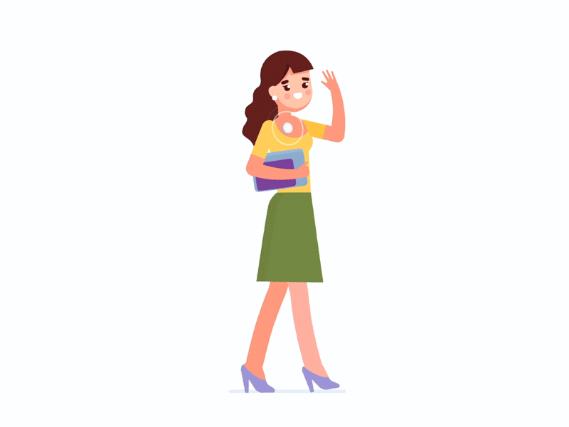
What is Workplace Culture?
It is the sum of a workplaces’ values, behaviors, beliefs and attitudes.
VALUES
BELIEFS
BEHAVIORS
ATTITUDES
Workplace Culture is the character and personality of your organization.
Is our culture the same as other departments in LAUSD?
We are Café LA. How would you describe our workplace culture?
Notes:
TELL: What is culture? The workplace culture is what we feel when we walk in, the vibe, and the energy. It is the personality of our organization. Every organization is different, google has their own company culture, In-N-Out has their own, LAUSD and its different departments do too!

Slide 9
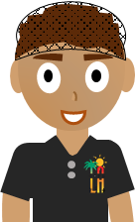
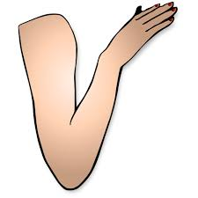
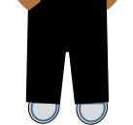
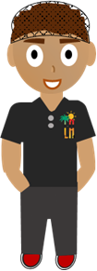
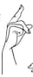
Unsafe
Threatened
Unhappy
Imagine working in an environment where you feel like you don’t belong.
Probably Not!
Unsafe
Would you be able to do your best work?
Threatened
Unhappy
Notes:
TELL: Now, take a moment to imagine as if you are working in an environment where you feel like you don’t belong.

Slide 10
Imagine working in an environment where you feel like you don’t belong.
Notes:
TELL: Now, take a moment to imagine as if you are working in an environment where you feel like you don’t belong.

Slide 11
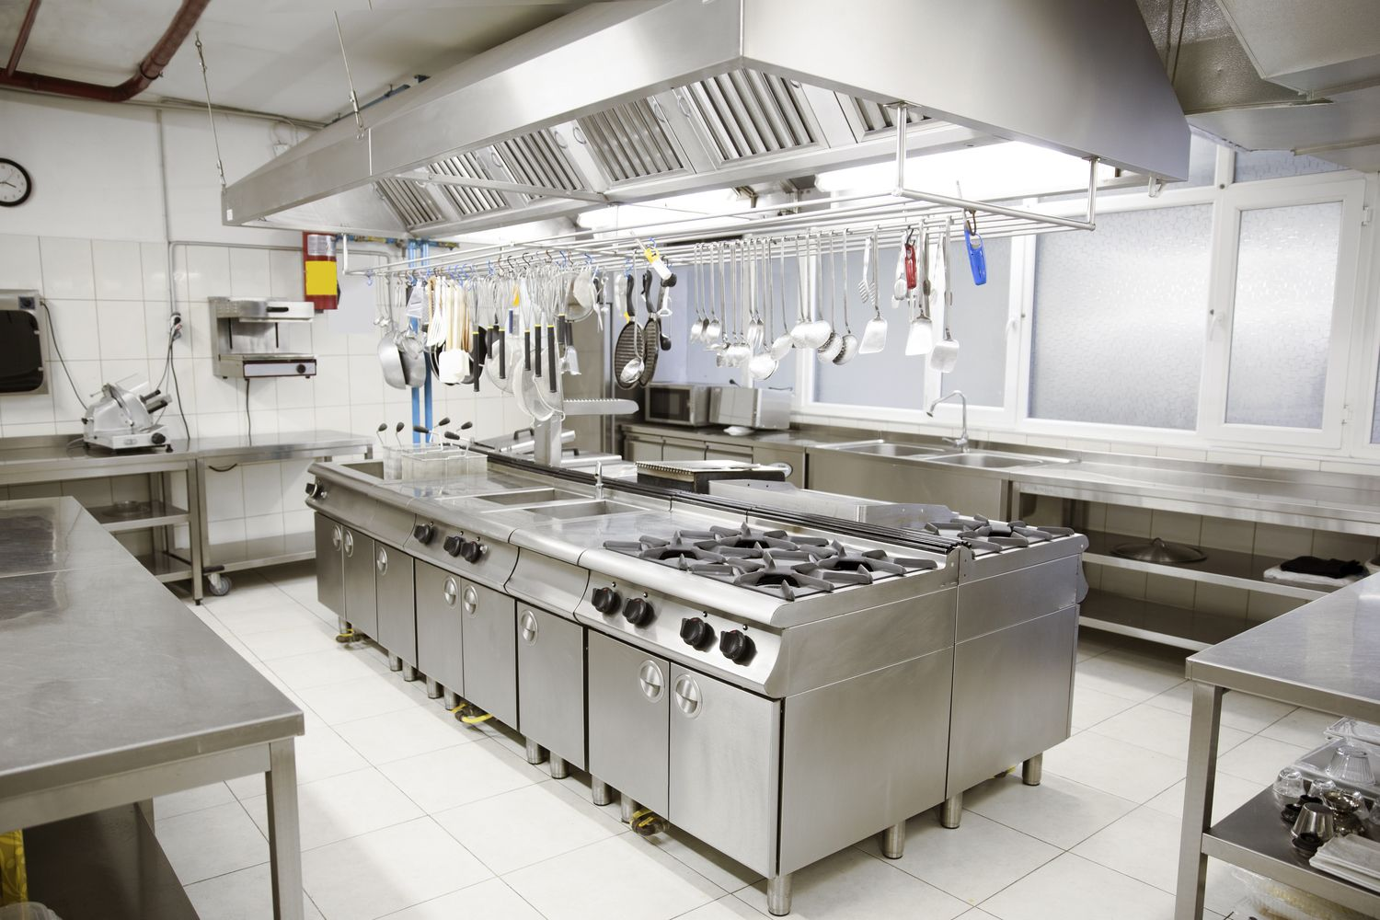
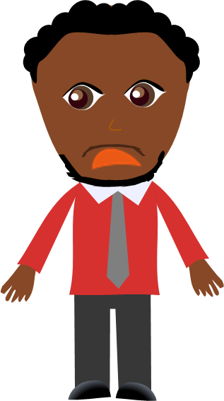
ABSOLUTELY NOT!
Would you be able to do your best work?
Threatened
Unhappy
Unsafe
Notes:
TELL: This workplace environment you’re in makes you feel threatened, unhappy, and unsafe.
ASK: Would you be able to do your best work?
INSTRUCTOR: Look for responses, verbal no’s or headshakes.
ASK: Does anyone here want to work in an environment where they can’t trust each other?
INSTRUCTOR: Look for responses, verbal no’s or headshakes.

Slide 12
Who do YOU want to be?
It's a simple question, and whether you know it or not,
you're answering it every day through your actions. Do you want to be someone who…
TEARS PEOPLE DOWN?
LIFTS PEOPLE
UP?
or
The Choice is Yours!
Notes:
ASK: Who do you want to be?
TELL: It's a simple question, and whether you know it or not, you're answering it every day through your actions.
CLICK
ASK: Are you someone how lifts people up?
CLICK:
ASK: Or tear people down?
TELL: Who you choose to be means everything.

Slide 13
Who do YOU want to be?
In order to lift people up, understanding their perception of what is considered disrespectful or unprofessional is essential to coming up with solutions to unite your team.
Notes:
ASK: Who do you want to be?
TELL: It's a simple question, and whether you know it or not, you're answering it every day through your actions.
CLICK
ASK: Are you someone how lifts people up?
CLICK:
ASK: Or tear people down?
TELL: Who you choose to be means everything.

Slide 14
Disrespectful vs Unprofessional
Please look at the 10 situations on the Disrespectful vs Unprofessional Worksheet in your packet.
Circle which word best describes each scenario: Disrespectful, Unprofessional, or Both.
Take 3 minutes to complete, and then we will discuss.
Notes:
ASK: What does a disrespectful workplace look like?
INSTRUCTOR: Solicit responses from audience
CLICK
TELL: A disrespectful workplace could look like a place where people are inconsiderate of others around them by talking too loudly and in a rude attitude or tone. They could also be playing personal music too loud that it distracts others, is constantly complaining and bringing others down with their negativity. Is non-inclusive of others and causes people to feel like an outsider. Wastes other people’s time but being late to meetings. Judging or criticizing other because they are different. Or never taking responsibility and passing blame to others. Giving certain people special treatment, or leaving a mess of shared spaces like the breakroom and restrooms. Telling offensive and inappropriate jokes. Gossiping about other, bullying, and even taking credit for other people’s work. Here are just some examples of what a disrespectful workplace could look like?

Slide 15
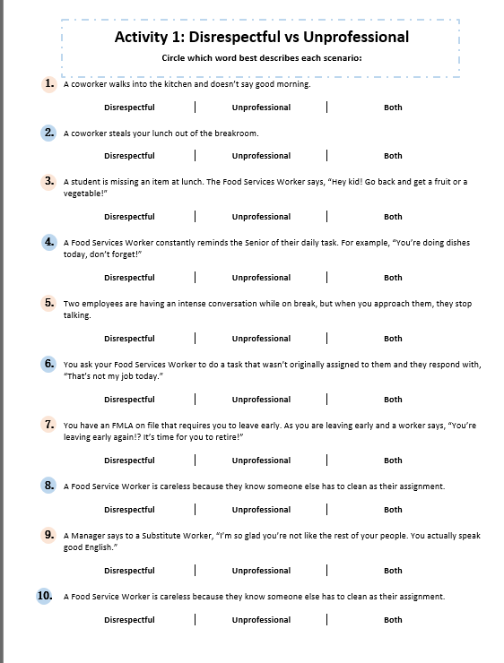
3 Minutes
Activity 1 - Let’s Begin!
Circle which word best describes each scenario: Disrespectful, Unprofessional, or Both.
Notes:
ASK: What does a disrespectful workplace look like?
INSTRUCTOR: Solicit responses from audience
CLICK
TELL: A disrespectful workplace could look like a place where people are inconsiderate of others around them by talking too loudly and in a rude attitude or tone. They could also be playing personal music too loud that it distracts others, is constantly complaining and bringing others down with their negativity. Is non-inclusive of others and causes people to feel like an outsider. Wastes other people’s time but being late to meetings. Judging or criticizing other because they are different. Or never taking responsibility and passing blame to others. Giving certain people special treatment, or leaving a mess of shared spaces like the breakroom and restrooms. Telling offensive and inappropriate jokes. Gossiping about other, bullying, and even taking credit for other people’s work. Here are just some examples of what a disrespectful workplace could look like?

Slide 16
A coworker walks into the kitchen and doesn’t say good morning.
This is unprofessional because it can be seen as poor workplace etiquette, however it is not disrespectful because it is not intended to insult or slight their coworkers.
1
Disrespectful
Unprofessional
Both
Notes:
ASK: What does a disrespectful workplace look like?
INSTRUCTOR: Solicit responses from audience
CLICK
TELL: A disrespectful workplace could look like a place where people are inconsiderate of others around them by talking too loudly and in a rude attitude or tone. They could also be playing personal music too loud that it distracts others, is constantly complaining and bringing others down with their negativity. Is non-inclusive of others and causes people to feel like an outsider. Wastes other people’s time but being late to meetings. Judging or criticizing other because they are different. Or never taking responsibility and passing blame to others. Giving certain people special treatment, or leaving a mess of shared spaces like the breakroom and restrooms. Telling offensive and inappropriate jokes. Gossiping about other, bullying, and even taking credit for other people’s work. Here are just some examples of what a disrespectful workplace could look like?

Slide 17
A coworker steals your lunch out of the breakroom.
This is both disrespectful and unprofessional because it can be seen as poor workplace etiquette, as well as a complete disregard for their coworkers personal belongings.
2
Disrespectful
Unprofessional
Both
Notes:
ASK: What does a disrespectful workplace look like?
INSTRUCTOR: Solicit responses from audience
CLICK
TELL: A disrespectful workplace could look like a place where people are inconsiderate of others around them by talking too loudly and in a rude attitude or tone. They could also be playing personal music too loud that it distracts others, is constantly complaining and bringing others down with their negativity. Is non-inclusive of others and causes people to feel like an outsider. Wastes other people’s time but being late to meetings. Judging or criticizing other because they are different. Or never taking responsibility and passing blame to others. Giving certain people special treatment, or leaving a mess of shared spaces like the breakroom and restrooms. Telling offensive and inappropriate jokes. Gossiping about other, bullying, and even taking credit for other people’s work. Here are just some examples of what a disrespectful workplace could look like?

Slide 18
This is unprofessional because the use of the phrase “Hey kid,” is below the standards expected of a Food Service Worker. It is not disrespectful because it is not intended to insult the child.
3
A student is missing an item at lunch. The Food Service Worker says, “Hey kid! Go back and get a fruit or a vegetable!”
Disrespectful
Unprofessional
Both
Notes:
ASK: What does a disrespectful workplace look like?
INSTRUCTOR: Solicit responses from audience
CLICK
TELL: A disrespectful workplace could look like a place where people are inconsiderate of others around them by talking too loudly and in a rude attitude or tone. They could also be playing personal music too loud that it distracts others, is constantly complaining and bringing others down with their negativity. Is non-inclusive of others and causes people to feel like an outsider. Wastes other people’s time but being late to meetings. Judging or criticizing other because they are different. Or never taking responsibility and passing blame to others. Giving certain people special treatment, or leaving a mess of shared spaces like the breakroom and restrooms. Telling offensive and inappropriate jokes. Gossiping about other, bullying, and even taking credit for other people’s work. Here are just some examples of what a disrespectful workplace could look like?

Slide 19
This is unprofessional because supervision is not in the job description of the Food Service Worker, however they may not be intending to undermine their Senior’s authority.
4
A Food Service Worker constantly reminds the Senior of their daily task.
For example, “You’re doing dishes today, don’t forget!”
Disrespectful
Unprofessional
Both
Notes:
ASK: What does a disrespectful workplace look like?
INSTRUCTOR: Solicit responses from audience
CLICK
TELL: A disrespectful workplace could look like a place where people are inconsiderate of others around them by talking too loudly and in a rude attitude or tone. They could also be playing personal music too loud that it distracts others, is constantly complaining and bringing others down with their negativity. Is non-inclusive of others and causes people to feel like an outsider. Wastes other people’s time but being late to meetings. Judging or criticizing other because they are different. Or never taking responsibility and passing blame to others. Giving certain people special treatment, or leaving a mess of shared spaces like the breakroom and restrooms. Telling offensive and inappropriate jokes. Gossiping about other, bullying, and even taking credit for other people’s work. Here are just some examples of what a disrespectful workplace could look like?

Slide 20
This is neither unprofessional nor disrespectful because employees are allowed to have private conversations on their break. Assume their conversation is not about you.
5
Two employees are having an intense conversation while on break, but when you approach them, they stop talking.
Trick Question!
Neither
Disrespectful
Unprofessional
Both
Notes:
ASK: What does a disrespectful workplace look like?
INSTRUCTOR: Solicit responses from audience
CLICK
TELL: A disrespectful workplace could look like a place where people are inconsiderate of others around them by talking too loudly and in a rude attitude or tone. They could also be playing personal music too loud that it distracts others, is constantly complaining and bringing others down with their negativity. Is non-inclusive of others and causes people to feel like an outsider. Wastes other people’s time but being late to meetings. Judging or criticizing other because they are different. Or never taking responsibility and passing blame to others. Giving certain people special treatment, or leaving a mess of shared spaces like the breakroom and restrooms. Telling offensive and inappropriate jokes. Gossiping about other, bullying, and even taking credit for other people’s work. Here are just some examples of what a disrespectful workplace could look like?

Slide 21
However it is not disrespectful because it is not intended to insult or undermine the authority of the manager. Objections aren’t inherently disrespectful.
This is unprofessional because it is improper to address a superior this way.
6
You ask your Food Service Worker to do a task that wasn’t originally assigned to them and they respond with,
“That’s not my job today.”
Disrespectful
Unprofessional
Both
Notes:
ASK: What does a disrespectful workplace look like?
INSTRUCTOR: Solicit responses from audience
CLICK
TELL: A disrespectful workplace could look like a place where people are inconsiderate of others around them by talking too loudly and in a rude attitude or tone. They could also be playing personal music too loud that it distracts others, is constantly complaining and bringing others down with their negativity. Is non-inclusive of others and causes people to feel like an outsider. Wastes other people’s time but being late to meetings. Judging or criticizing other because they are different. Or never taking responsibility and passing blame to others. Giving certain people special treatment, or leaving a mess of shared spaces like the breakroom and restrooms. Telling offensive and inappropriate jokes. Gossiping about other, bullying, and even taking credit for other people’s work. Here are just some examples of what a disrespectful workplace could look like?

Slide 22
It is unprofessional because supervising is not in the job description of a worker. It’s disrespectful because the comment about retiring clearly shows the worker has a bias against your age.
7
You have an FMLA on file that requires you to leave early. As you are leaving early a worker says, “You’re leaving early again!? It’s time for you to retire!”
Disrespectful
Unprofessional
Both
Notes:
ASK: What does a disrespectful workplace look like?
INSTRUCTOR: Solicit responses from audience
CLICK
TELL: A disrespectful workplace could look like a place where people are inconsiderate of others around them by talking too loudly and in a rude attitude or tone. They could also be playing personal music too loud that it distracts others, is constantly complaining and bringing others down with their negativity. Is non-inclusive of others and causes people to feel like an outsider. Wastes other people’s time but being late to meetings. Judging or criticizing other because they are different. Or never taking responsibility and passing blame to others. Giving certain people special treatment, or leaving a mess of shared spaces like the breakroom and restrooms. Telling offensive and inappropriate jokes. Gossiping about other, bullying, and even taking credit for other people’s work. Here are just some examples of what a disrespectful workplace could look like?

Slide 23
However, if the worker only does this behavior on days when a certain coworker has to clean that area, then it would be both, because they are targeting one person.
This is unprofessional because it is in the job description of a Food Services Worker to keep their workspace clean. It is not disrespectful because it is not directed at a specific coworker.
8
A Food Service Worker is careless with their work area because they know someone else has to clean as their assignment.
Disrespectful
Unprofessional
Both
Notes:
ASK: What does a disrespectful workplace look like?
INSTRUCTOR: Solicit responses from audience
CLICK
TELL: A disrespectful workplace could look like a place where people are inconsiderate of others around them by talking too loudly and in a rude attitude or tone. They could also be playing personal music too loud that it distracts others, is constantly complaining and bringing others down with their negativity. Is non-inclusive of others and causes people to feel like an outsider. Wastes other people’s time but being late to meetings. Judging or criticizing other because they are different. Or never taking responsibility and passing blame to others. Giving certain people special treatment, or leaving a mess of shared spaces like the breakroom and restrooms. Telling offensive and inappropriate jokes. Gossiping about other, bullying, and even taking credit for other people’s work. Here are just some examples of what a disrespectful workplace could look like?

Slide 24
This statement might not be ill-intended, but it is still disrespectful because the manager is comparing people from a certain ethnic/national/race group.
This shows a bias held by the manager, whether consciously or unconsciously.
This is unprofessional because it is not in the job description of a manager to grade a workers levels of English proficiency.
9
A Manager says to a Substitute Worker, “I’m so glad you’re not like the rest of your people. You actually speak good English.”
Disrespectful
Unprofessional
Both
Notes:
ASK: What does a disrespectful workplace look like?
INSTRUCTOR: Solicit responses from audience
CLICK
TELL: A disrespectful workplace could look like a place where people are inconsiderate of others around them by talking too loudly and in a rude attitude or tone. They could also be playing personal music too loud that it distracts others, is constantly complaining and bringing others down with their negativity. Is non-inclusive of others and causes people to feel like an outsider. Wastes other people’s time but being late to meetings. Judging or criticizing other because they are different. Or never taking responsibility and passing blame to others. Giving certain people special treatment, or leaving a mess of shared spaces like the breakroom and restrooms. Telling offensive and inappropriate jokes. Gossiping about other, bullying, and even taking credit for other people’s work. Here are just some examples of what a disrespectful workplace could look like?

Slide 25
It is disrespectful because the worker is intending to cause harm to the reputations of their coworkers.
This is unprofessional because giving performance reviews is not in the job description of a Food Service Worker
10
A Food Service Worker gossips around the school that all their coworkers are lazy.
Disrespectful
Unprofessional
Both
Notes:
ASK: What does a disrespectful workplace look like?
INSTRUCTOR: Solicit responses from audience
CLICK
TELL: A disrespectful workplace could look like a place where people are inconsiderate of others around them by talking too loudly and in a rude attitude or tone. They could also be playing personal music too loud that it distracts others, is constantly complaining and bringing others down with their negativity. Is non-inclusive of others and causes people to feel like an outsider. Wastes other people’s time but being late to meetings. Judging or criticizing other because they are different. Or never taking responsibility and passing blame to others. Giving certain people special treatment, or leaving a mess of shared spaces like the breakroom and restrooms. Telling offensive and inappropriate jokes. Gossiping about other, bullying, and even taking credit for other people’s work. Here are just some examples of what a disrespectful workplace could look like?

Slide 26
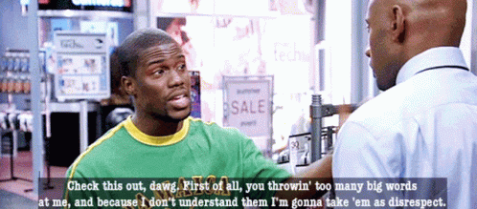
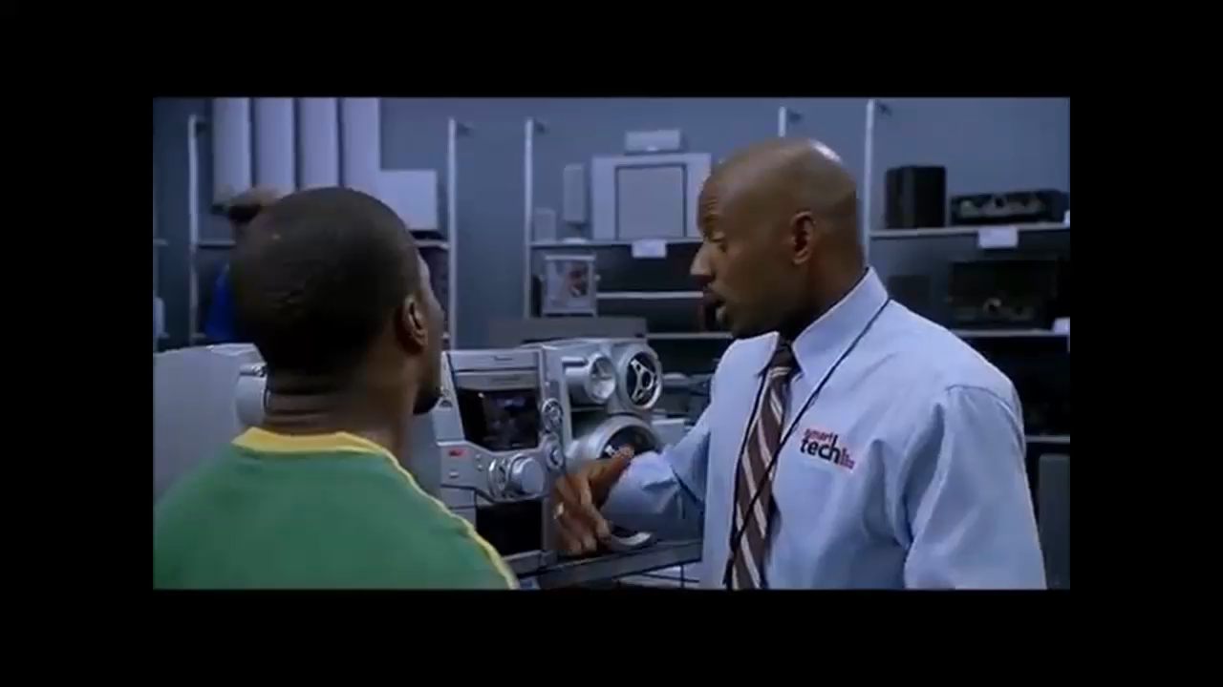
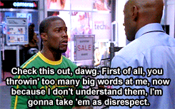
Take a breathe before reacting. Do not accidently introduce disrespect by having a knee-jerk reaction.
Try to get to a place where you everything you don’t like doesn’t feel like disrespect
Disrespectful vs Unprofessional
Do not accidently introduce disrespect into a situation, by having a knee-jerk reaction
Try to get to a place, where everything you don’t like doesn’t feel like disrespect
Many times in the workplace, the unprofessional actions of an individual can be mistaken as disrespectful
What is taken as disrespect is determined by the person who feels disrespected
Often, the act, no matter how unprofessional, is not intended to be disrespectful to a person
Notes:
ASK: What does a disrespectful workplace look like?
INSTRUCTOR: Solicit responses from audience
CLICK
TELL: A disrespectful workplace could look like a place where people are inconsiderate of others around them by talking too loudly and in a rude attitude or tone. They could also be playing personal music too loud that it distracts others, is constantly complaining and bringing others down with their negativity. Is non-inclusive of others and causes people to feel like an outsider. Wastes other people’s time but being late to meetings. Judging or criticizing other because they are different. Or never taking responsibility and passing blame to others. Giving certain people special treatment, or leaving a mess of shared spaces like the breakroom and restrooms. Telling offensive and inappropriate jokes. Gossiping about other, bullying, and even taking credit for other people’s work. Here are just some examples of what a disrespectful workplace could look like?

Slide 27
Disrespectful vs Unprofessional
What people take as disrespect varies from person to person, so let’s look at the definitions.
Disrespect: show a lack of respect for; insult
Unprofessional: below or contrary to the standards expected in a profession
Notes:
ASK: What does a disrespectful workplace look like?
INSTRUCTOR: Solicit responses from audience
CLICK
TELL: A disrespectful workplace could look like a place where people are inconsiderate of others around them by talking too loudly and in a rude attitude or tone. They could also be playing personal music too loud that it distracts others, is constantly complaining and bringing others down with their negativity. Is non-inclusive of others and causes people to feel like an outsider. Wastes other people’s time but being late to meetings. Judging or criticizing other because they are different. Or never taking responsibility and passing blame to others. Giving certain people special treatment, or leaving a mess of shared spaces like the breakroom and restrooms. Telling offensive and inappropriate jokes. Gossiping about other, bullying, and even taking credit for other people’s work. Here are just some examples of what a disrespectful workplace could look like?

Slide 28
Results!
If you were keeping score there were:
0
Disrespectful
5
Unprofessional
4
Both
In the workplace, any action that is disrespectful is automatically unprofessional, but not every unprofessional action is disrespectful.
Notes:
ASK: What does a disrespectful workplace look like?
INSTRUCTOR: Solicit responses from audience
CLICK
TELL: A disrespectful workplace could look like a place where people are inconsiderate of others around them by talking too loudly and in a rude attitude or tone. They could also be playing personal music too loud that it distracts others, is constantly complaining and bringing others down with their negativity. Is non-inclusive of others and causes people to feel like an outsider. Wastes other people’s time but being late to meetings. Judging or criticizing other because they are different. Or never taking responsibility and passing blame to others. Giving certain people special treatment, or leaving a mess of shared spaces like the breakroom and restrooms. Telling offensive and inappropriate jokes. Gossiping about other, bullying, and even taking credit for other people’s work. Here are just some examples of what a disrespectful workplace could look like?

Slide 29
“Without appreciation and respect for other people, true leadership becomes ineffective, if not impossible.”
–George Foreman

Slide 30
Discussion Activity
Be aware of facial expression & body language
Practice appropriate volume control
Pay
attention /listen
Respect for shared spaces and items
Don’t be negative
Greet/ acknowledge coworkers
Practice
good
hygiene
What are some ways to show respect in the workplace?
Smile
Treat everyone the same
Be on time
Notes:
ASK: What are some ways to show respect in the workplace?
INSTRUCTOR: Solicit responses from audience
CLICK
TELL: Here are some ways you can show respect in the workplace. A bulk of our communication is happens nonverbally through facial expressions and body language. It is important to be aware of the impression we’re giving off to others. Another is showing respect for shared spaces and items by cleaning up after yourself in the breakroom. Treating everyone the same, practicing good hygiene, giving your full attention and listening, not being negative and bringing positive vibes only. Respecting other people’s time by being on time to meetings. And even something as simple as smiling.

Slide 31
“You can’t control other people’s behavior, but you can control your responses to it.”
–Roberta Cava
Notes:
TELL: “You cannot control other people’s actions. You can only control your own actions.”

Slide 32
How can you turn this into a professional conversation with your worker?
You ask your Food Services Worker to do a task that wasn’t originally assigned to them and they respond with, “That’s not my job today.”
6
Together, let’s look at a statement that was deemed unprofessional and discuss how we can handle it in a professional manner.
Notes:
ASK: What change results from turning disrespectful actions to respectful ones?
INSTRUCTOR: Solicit responses from audience
CLICK
TELL: A respectful workplace culture has many positive benefits. It creates a pleasant and fair environment for all, boosts productivity, increase job satisfaction, fosters teamwork, improves communication with one another. Kindness and positive vibes are in the air, employees are much happier and less stressed.

Slide 33
Activity 2
Together, let’s look at a scenario that was deemed unprofessional and discuss how we can handle it in a professional manner.
Notes:
ASK: What change results from turning disrespectful actions to respectful ones?
INSTRUCTOR: Solicit responses from audience
CLICK
TELL: A respectful workplace culture has many positive benefits. It creates a pleasant and fair environment for all, boosts productivity, increase job satisfaction, fosters teamwork, improves communication with one another. Kindness and positive vibes are in the air, employees are much happier and less stressed.

Slide 34
The Scenario
Professional Response
Response
Unprofessional Response
You ask your Food Services Worker to do a task that wasn’t originally assigned to them and they respond with, “That’s not my job today.”
How we respond determines whether we are professional or unprofessional.
“I don’t care if that’s your job today! That’s what I’m telling you to do.”
I understand you weren’t assigned that task today, however, as noted on the Cafeteria Assignment Schedule, schedules are subject to change. I needed to switch tasks around today, for operational purposes. Thank you for your flexibility.
Do you think they would be more receptive?
Notes:
ASK: What change results from turning disrespectful actions to respectful ones?
INSTRUCTOR: Solicit responses from audience
CLICK
TELL: A respectful workplace culture has many positive benefits. It creates a pleasant and fair environment for all, boosts productivity, increase job satisfaction, fosters teamwork, improves communication with one another. Kindness and positive vibes are in the air, employees are much happier and less stressed.

Slide 35
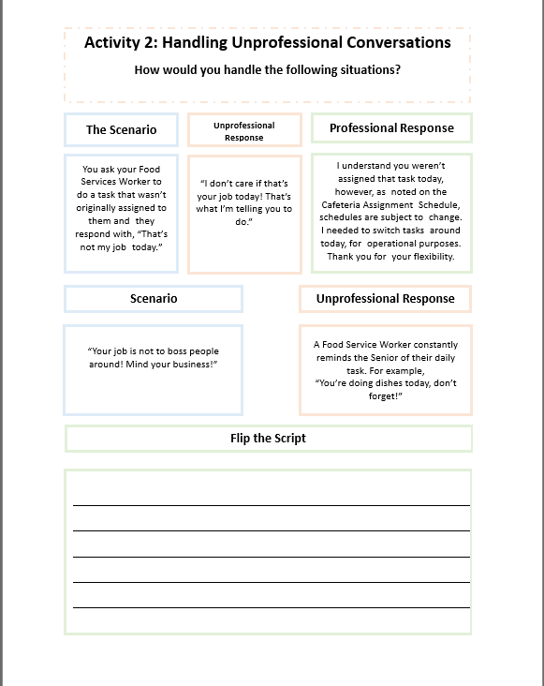
Activity 2 – Handling Unprofessional Conversations
Using the backside of your worksheet, look at the second scenario
Do you think they would be more receptive?
Notes:
ASK: What change results from turning disrespectful actions to respectful ones?
INSTRUCTOR: Solicit responses from audience
CLICK
TELL: A respectful workplace culture has many positive benefits. It creates a pleasant and fair environment for all, boosts productivity, increase job satisfaction, fosters teamwork, improves communication with one another. Kindness and positive vibes are in the air, employees are much happier and less stressed.

Slide 36
The Scenario
Unprofessional Response
Flip the Script
“Your job is not to boss people around! Mind your business!”
A Food Service Worker constantly reminds the Senior of their daily task.
For example, “You’re doing dishes today, don’t forget!”
How can you turn this into a professional conversation with your worker?
Take 2 minutes to write an appropriate response in the blank space on Activity 2.
Notes:
ASK: What change results from turning disrespectful actions to respectful ones?
INSTRUCTOR: Solicit responses from audience
CLICK
TELL: A respectful workplace culture has many positive benefits. It creates a pleasant and fair environment for all, boosts productivity, increase job satisfaction, fosters teamwork, improves communication with one another. Kindness and positive vibes are in the air, employees are much happier and less stressed.

Slide 37
Scenario
4
A Food Service Worker constantly reminds the Senior of their daily task.
For example, “You’re doing dishes today, don’t forget!”
Discussion
Let’s look at another example.
Notes:
ASK: What change results from turning disrespectful actions to respectful ones?
INSTRUCTOR: Solicit responses from audience
CLICK
TELL: A respectful workplace culture has many positive benefits. It creates a pleasant and fair environment for all, boosts productivity, increase job satisfaction, fosters teamwork, improves communication with one another. Kindness and positive vibes are in the air, employees are much happier and less stressed.

Slide 38
Discussion Activity
What professional outcomes result from turning disrespectful actions to respectful actions?
Notes:
ASK: What change results from turning disrespectful actions to respectful ones?
INSTRUCTOR: Solicit responses from audience
CLICK
TELL: A respectful workplace culture has many positive benefits. It creates a pleasant and fair environment for all, boosts productivity, increase job satisfaction, fosters teamwork, improves communication with one another. Kindness and positive vibes are in the air, employees are much happier and less stressed.

Slide 39
Discussion Activity
Commitment
Boosts Productivity
Teamwork
Fair Environment
Job Satisfaction
Positive Vibes
Better Communication
What outcome results from turning disrespectful actions to respectful ones?
Happy
Co-Workers
Kindness
Less Stress
Notes:
ASK: What change results from turning disrespectful actions to respectful ones?
INSTRUCTOR: Solicit responses from audience
CLICK
TELL: A respectful workplace culture has many positive benefits. It creates a pleasant and fair environment for all, boosts productivity, increase job satisfaction, fosters teamwork, improves communication with one another. Kindness and positive vibes are in the air, employees are much happier and less stressed.

Slide 40
CONFLICT
IN THE KITCHEN
Notes:
TRANSITION SLIDE ONLY

Slide 41
Close Quarters
When working in a kitchen, you will face conflict.
Kitchens are tight working spaces
There is no escape from your coworkers
Your breaks might be at the same time
Many different personalities
So how do you deal with it?

Slide 42
Close Quarters
When working in a kitchen, conflict will arise because:
Tight Working Spaces
Same Schedule Every Week
Breaks At The Same Time
Many Different Personalities
So how do you deal with it?
Notes:
TELL: When a group of people work together day after day, conflict is inevitable, but how you react to conflict is your choice.
CLICK
TELL: When you find yourself in a heated conflict, first you want take a moment to cool off and gather your thoughts. Do not ignore the situation or it will blow up when you least expect it. Talk it over calmly, be sure to watch your tone and words used. Communication is a two-way street, it consists of both talking and listening. It is important to listen carefully and attentively to what the other person has to say. And lastly, it is important to remember that it is completely alright to agree to disagree peacefully.

Slide 43
Dealing With Conflict
Conflict maybe unavoidable, but how you react to conflict is your choice.
Cool Off & Gather Your Thoughts
Talk It Over, Watch Your Tone & Words Used
Listen Carefully & Attentively
Agree To Disagree
Know When To Seek Guidance
Notes:
TELL: When a group of people work together day after day, conflict is inevitable, but how you react to conflict is your choice.
CLICK
TELL: When you find yourself in a heated conflict, first you want take a moment to cool off and gather your thoughts. Do not ignore the situation or it will blow up when you least expect it. Talk it over calmly, be sure to watch your tone and words used. Communication is a two-way street, it consists of both talking and listening. It is important to listen carefully and attentively to what the other person has to say. And lastly, it is important to remember that it is completely alright to agree to disagree peacefully.

Slide 44
Word Choice: “You” Versus “I” Statements
“You” statements escalate conflict by making the listener feel blamed, judged or criticized, causing them to feel angry, defensive or withdrawn.
“I” statements make it easier for the listener to hear what we are actually saying, even when we are upset or frustrated.
You never listen to me.
I feel unheard, can we talk?
I am busy; can you give me a hand?
You never help, you’re useless!
Why are you being nosy? It’s none of your business.
I do not feel comfortable sharing something so personal.
Notes:
TELL: Let’s talk about the words we choose to use in conflict. “You” statements escalate conflict by making the listener feel blamed, judged or criticized, causing them to feel angry, defensive or withdrawn.
CLICK
TELL: Here are examples of “You” or finger-pointing statements.
INSTRUCTOR: Read examples with extreme attitude.
TELL: You never listen to me. You are of no help at all! Why are you being nosy? It’s none of your business.
TELL: Now let’s talk about “I” statements. Where the focus is shifted from the listener to the speaker. “I” statements make it easier for the listener to hear what we are actually saying, even when we are upset or frustrated.
TELL: Instead of saying You never listen to me.
CLICK
TELL: Say I feel unheard, can we talk?
TELL: Instead of saying You are of no help at all!
CLICK
TELL: Say I am really busy and would appreciate some extra help.
TELL: Instead of saying Why are you being nosy? It’s none of your business.
CLICK
TELL: Say I do not feel comfortable sharing something so personal.
TELL: By choosing to use the “I” statements instead of the “You” Statements, we shift the focus from the listener to the speaker. And the tone of the statements are drastically changed from aggressive and accusing to owning the emotions without changing the message.

Slide 45
Your Tone of Voice Matters
It’s not just what you say, but how you say it.
Bye!
Positive Tone
Negative Tone
Yeah, sure!
Positive Tone
Negative Tone
Notes:
TELL: Your tone of voice matters. It’s not just what you said, but how you say it. Let’s take a closer look at these examples.
CLICK
TELL: Now I will say the statement in a positive tone.
INSTRUCTOR: Exaggerate positive and joy in tone of voice.
TELL: Thanks a lot! Now let’s do the opposite.
INSTRUCTOR: Exaggerate negative and anger in tone of voice.
TELL: Thanks a lot!
ASK: Would anyone like to volunteer for the next example?
ASK: How would you say this in a positive tone?
INSTRUCTOR: Exaggerate positive and joy in tone of voice.
TELL: Nice Job! Now let’s do the opposite.
ASK: How would you say the same statement in a negative tone?
INSTRUCTOR: Exaggerate negative and anger in tone of voice.
TELL: Nice job!
ASK: It’s the same statement, but did we give it a different meaning when we said it differently?

Slide 46
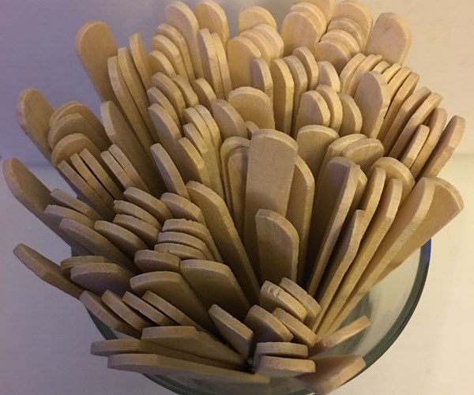

Tone Activity
The popsicle sticks all have two words on them. Your job is to say the 1st word in the tone of the second word.
Good Bye
Anger

Slide 47
THE
5/10
WAY
Notes:
TRANSITION SLIDE ONLY

Slide 48
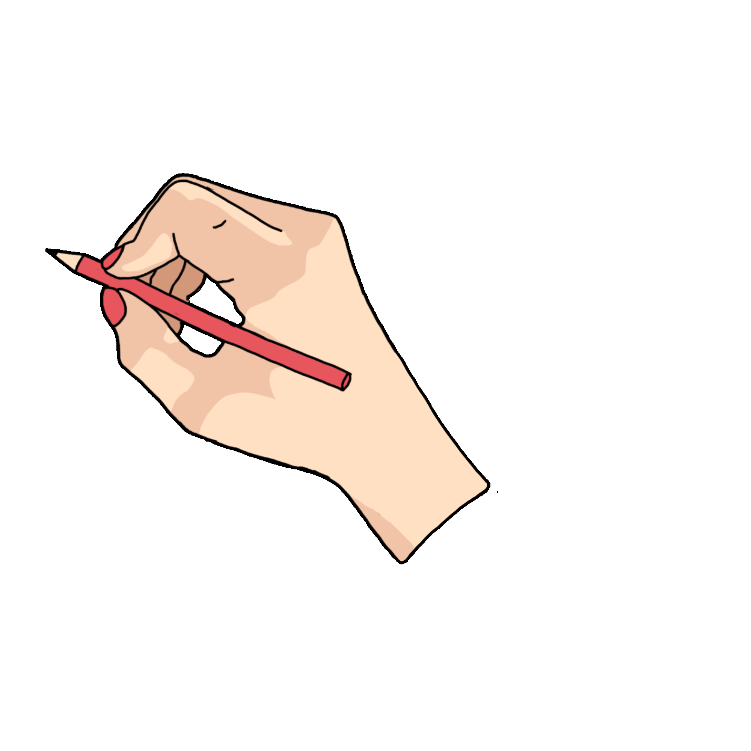
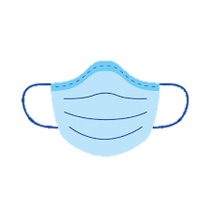

What is the “5/10 Way”?
6
10 FT NONVERBAL CONTACT
SMILE & EYE CONTACT
The “5/10 Way” is the action you practice when you walk by another person to acknowledge their existence.
5 FT VERBAL CONTACT
SAY “HELLO!”
During the Covid-19 pandemic make sure to social distance (6 ft. apart) and wear a mask!
Good morning!
Hey there!
A little kindness goes a long way.
YOU
Notes:
TELL: The 5/10 Way are two simple actions you practice when you walk by another person.
CLICK
TELL: At 10 ft, engage in non-verbal contact like smiling and giving eye contact.
CLICK
TELL: At 5 ft, engage in verbal contact and greet or say hello to the other person.
TELL: You’ll be surprised, a little kindness goes a long way.

Slide 49
The 5/10 Way During Covid-19
6
6 FT VERBAL CONTACT
SAY “HELLO!”
10 FT NONVERBAL CONTACT
SMILE & EYE CONTACT
Convey the message using other facial clues such as raised eyebrows, squinting and scrunching around the eyes.
Sometimes the mask can muffle your voice, but please don’t yell or pull down your mask!
Maintain your distance, but don’t be afraid to greet!
Instead, use body language to assist your greeting. Try giving a wave!
The 5 FT rule has been adjusted to 6 FT.
However, during this pandemic, many people have masks on.
The 10 FT rule requires smiling and eye contact.
Good morning!
Hey there!
Use Body Language!
Notes:
TELL: The 5/10 Way are two simple actions you practice when you walk by another person.
CLICK
TELL: At 10 ft, engage in non-verbal contact like smiling and giving eye contact.
CLICK
TELL: At 5 ft, engage in verbal contact and greet or say hello to the other person.
TELL: You’ll be surprised, a little kindness goes a long way.

Slide 50
The 5/10 Way During Covid-19
However, during this pandemic, many people have masks on. So the message has to be conveyed using body language.
The 10 FT rule requires smiling and eye contact.
6
5 FT VERBAL CONTACT
SAY “HELLO!”
10 FT NONVERBAL CONTACT
SMILE & EYE CONTACT
Good morning!
Hey there!
Body Language!
Notes:
TELL: The 5/10 Way are two simple actions you practice when you walk by another person.
CLICK
TELL: At 10 ft, engage in non-verbal contact like smiling and giving eye contact.
CLICK
TELL: At 5 ft, engage in verbal contact and greet or say hello to the other person.
TELL: You’ll be surprised, a little kindness goes a long way.

Slide 51





Small Actions That Strengthen Culture
Something simple like acknowledging others and smiling have a big impact.
Successful companies of theme parks, hotel chains, retail stores, and even hospitals practice some form of the 5/10 way.
Notes:
TELL: Something simple like acknowledging others and smiling have a big impact.
CLICK TELL: Successful companies of theme parks, hotel chains, retail stores, and even hospitals practice some form of the 5/10 way not only with their customers but also each other. So what is the 5/10 Way and what is it all about?

Slide 52
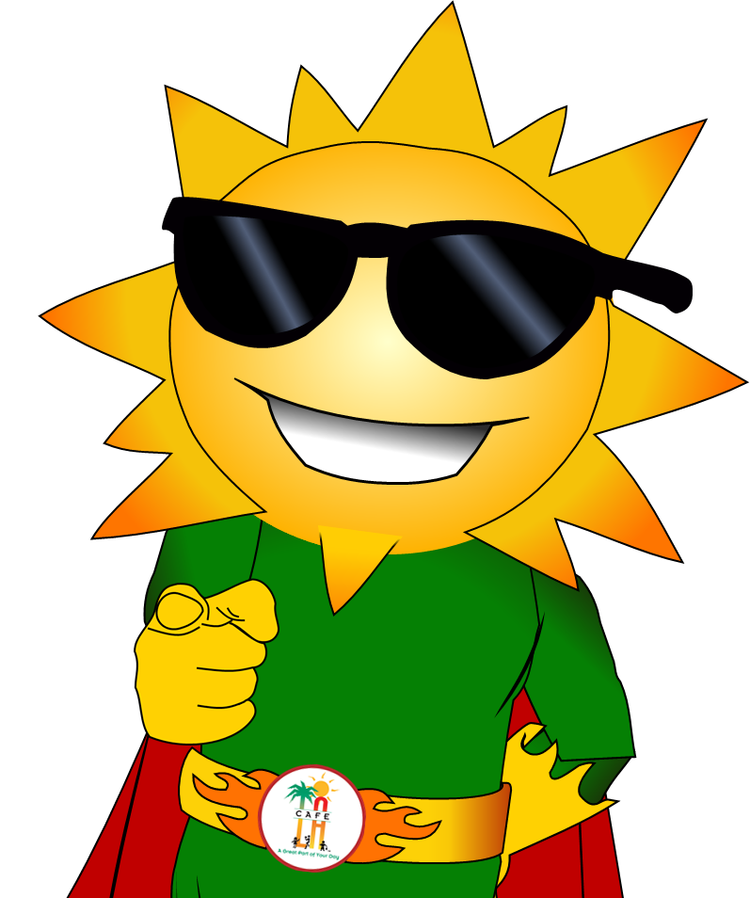

We challenge you to try The 5/10 Way every single day!
6
Notes:
Tell: Café LA Ray challenges you to practice the 5/10 Way every single day!

Slide 53
Do you know anyone who has been hesitant to change?
When change is looked at as an opportunity, team members will be more receptive.
Changing culture takes time because people are resistant to change.
Change has to be implemented gradually, and with an optimistic outlook.
Staff grow comfortable with their current circumstances.
Be Patient!

Slide 54
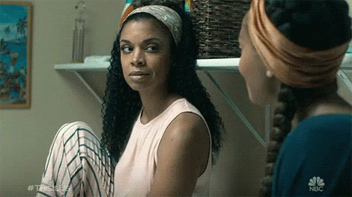
Your Emotions are Contagious
QUESTION:
Have you ever had someone laugh, or smile at you, and you instinctively smiled back, no matter how you were feeling?
WHY DOES THIS HAPPEN?
Mirror neurons in your brain cause you to unconsciously mimic actions around you, like a yawn or a smile. Emotions can also be contagious, like stress, anxiety and joy.
Notes:
INSTRUCTOR: Start this slide by yawning as if you are doing it unintentionally and naturally.
ASK: I have a question for all of you. Have you ever yawned, not because you were tired or sleepy, but because you saw someone else yawn first?
ASK: Why does that happen to us? What does a mirror do?
TELL: It reflects our image, right. Well, we have mirror neurons in your brain cause you to unconsciously mimic actions around you, like a yawn or a smile.
TELL: But, research shows that not only yawns and smiles are contagious but also negative emotions like stress, anxiety, boredom, and positive emotions like joy, confidence and commitment.

Slide 55
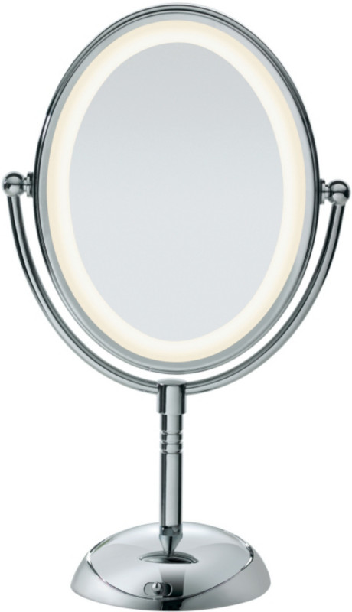
What Mirror Will You Hold Up?
What you show your team will be reflected back upon you.
What is your reflection going to be?
Notes:
INSTRUCTOR: Start this slide by yawning as if you are doing it unintentionally and naturally.
ASK: I have a question for all of you. Have you ever yawned, not because you were tired or sleepy, but because you saw someone else yawn first?
ASK: Why does that happen to us? What does a mirror do?
TELL: It reflects our image, right. Well, we have mirror neurons in your brain cause you to unconsciously mimic actions around you, like a yawn or a smile.
TELL: But, research shows that not only yawns and smiles are contagious but also negative emotions like stress, anxiety, boredom, and positive emotions like joy, confidence and commitment.

Slide 56
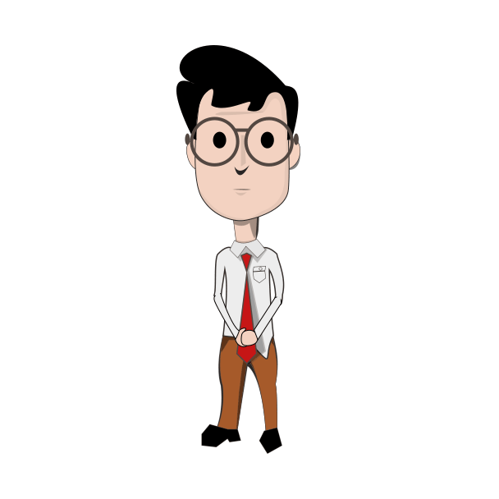
You’re Actions are Contagious
QUESTION:
Have you ever yawned, not because you were tired or sleepy, but because you saw someone else yawn first?
WHY?
Mirror neurons in your brain cause you to unconsciously mimic actions around you, like a yawn or a smile.
RESEARCH SHOWS:
Not only yawns and smiles are contagious but also negative emotions like stress, anxiety, boredom, and positive emotions like joy, confidence and commitment.
Notes:
INSTRUCTOR: Start this slide by yawning as if you are doing it unintentionally and naturally.
ASK: I have a question for all of you. Have you ever yawned, not because you were tired or sleepy, but because you saw someone else yawn first?
ASK: Why does that happen to us? What does a mirror do?
TELL: It reflects our image, right. Well, we have mirror neurons in your brain cause you to unconsciously mimic actions around you, like a yawn or a smile.
TELL: But, research shows that not only yawns and smiles are contagious but also negative emotions like stress, anxiety, boredom, and positive emotions like joy, confidence and commitment.

Slide 57
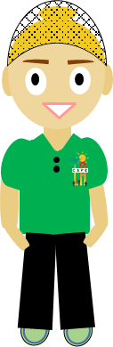
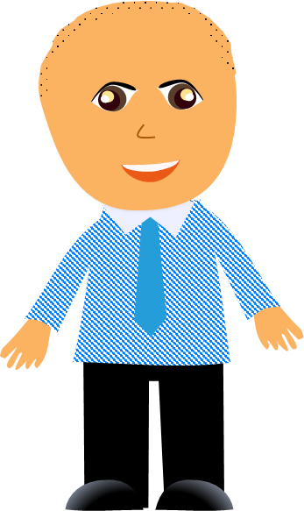
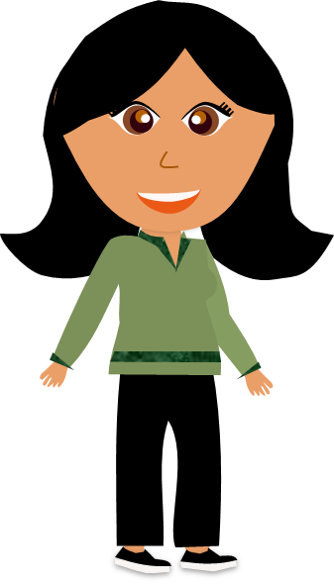
Respect in the Workplace Starts With You
No matter what your role is, you have the choice to create a respectful workplace culture.
Notes:
TELL: Respect in the workplace starts with you. Whether you’re a worker, manager, or a supervisor, you have the choice to create a respectful workplace culture.

Slide 58
As a Reminder
You are required to review all assigned documents. By completing this training you are certifying you have viewed all the required documents and this training in its entirety.
LAUSD Food Services Division
Nourishing Children to Achieve Excellence
Notes:
TELL: Thank you for joining me today. As a reminder, you are required to review all assigned documents. By completing this training you are certifying you have viewed all the required documents and this training in its entirety.

Slide 59
Thank You!
LAUSD Food Services Division
Nourishing Children to Achieve Excellence
Notes:
TELL: Thank you for joining me today. As a reminder, you are required to review all assigned documents. By completing this training you are certifying you have viewed all the required documents and this training in its entirety.

Slide 60
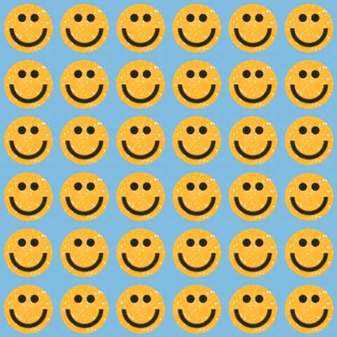
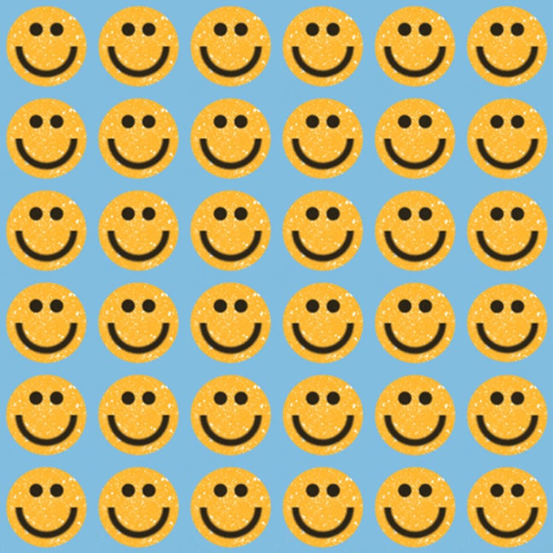
Positive energy is contagious.
Negative energy is also contagious.
THE CHOICE
IS YOURS.
What kind of environment would you like to work in?
Notes:
TELL: So, we just learned that positive energy is contagious, but so is negative energy.
ASK: What kind of environment would you like to work in?
TELL: The choice is yours.

